Slide 1








Lesson 1. template vs templateurl

Slide 2
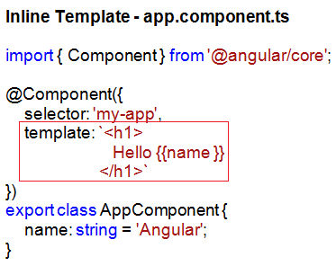

What is a Component in Angular 4
Angular template vs templateUrl
With an inline template
We loose Visual Studio editor intellisense, code-completion and formatting features
TypeScript code is not easier to read and understand when it is mixed with the inline template HTML

Slide 3
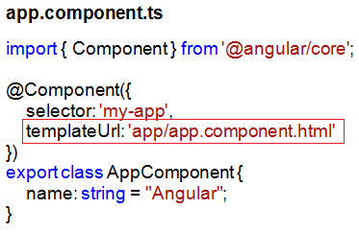
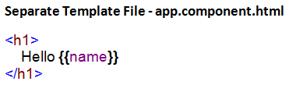
Angular template vs templateUrl
With an external view template
We have Visual Studio editor intellisense, code-completion and formatting features
Not only the code in "app.component.ts" is clean, it is also easier to read and understand
With an external view template
We have Visual Studio editor intellisense, code-completion and formatting features
Not only the code in "app.component.ts" is clean, it is also easier to read and understand

Slide 4
Q & A
Contact:rashmipawaskar@synergetics-india.com

Slide 5
Thank You

